Slide 1
Computer vision: models, learning and inference
Chapter 16
Multiple Cameras
Notes:
http://research.google.com/pubs/pub37112.html
http://grail.cs.washington.edu/rome/
http://grail.cs.washington.edu/projects/interior/
http://phototour.cs.washington.edu/
http://phototour.cs.washington.edu/PhotoTourismPreview-640x480.mov
BigBed: http://photosynth.net/view.aspx?cid=877fce1c-4aa9-405c-8024-4fa1dce6a84f
Trevi Fountain: http://photosynth.net/view.aspx?cid=8089d414-fa91-4828-b88f-df07173edee4

Slide 2
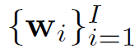
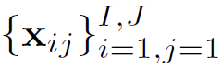
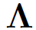
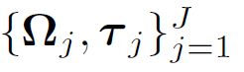
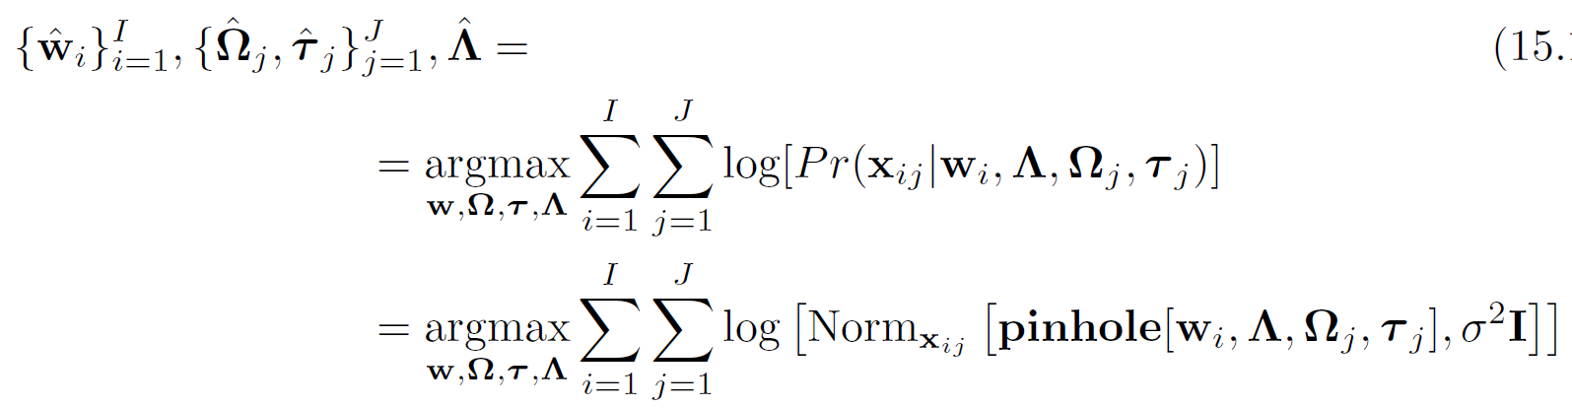
Structure from motion
Given
an object that can be characterized by I 3D points
projections into J images
Find
Intrinsic matrix
Extrinsic matrix for each of J images
3D points
Computer vision: models, learning and inference. ©2011 Simon J.D. Prince
2

Slide 3
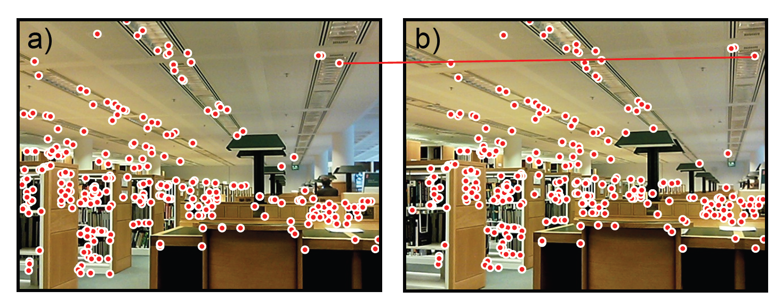
Structure from motion
For simplicity, we’ll start with simpler problem
Just J=2 images
Known intrinsic matrix
Computer vision: models, learning and inference. ©2011 Simon J.D. Prince
3

Slide 4


Structure
Two view geometry
The essential and fundamental matrices
Reconstruction pipeline
Rectification
Multi-view reconstruction
Applications
Computer vision: models, learning and inference. ©2011 Simon J.D. Prince
4

Slide 5
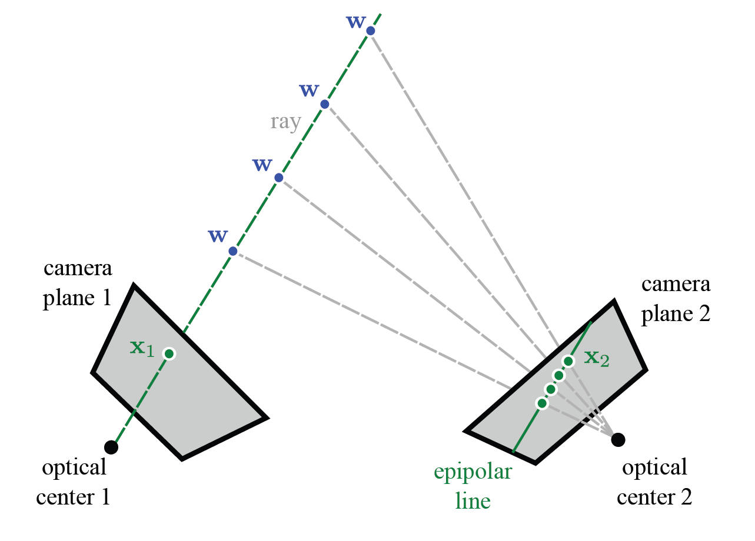



















Epipolar lines
Computer vision: models, learning and inference. ©2011 Simon J.D. Prince
5

Slide 6
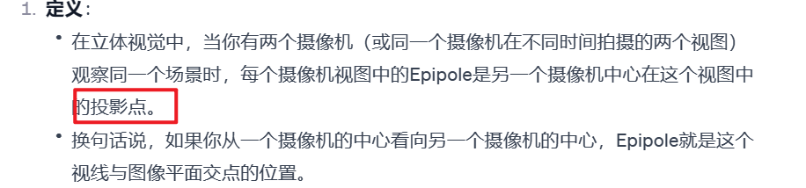
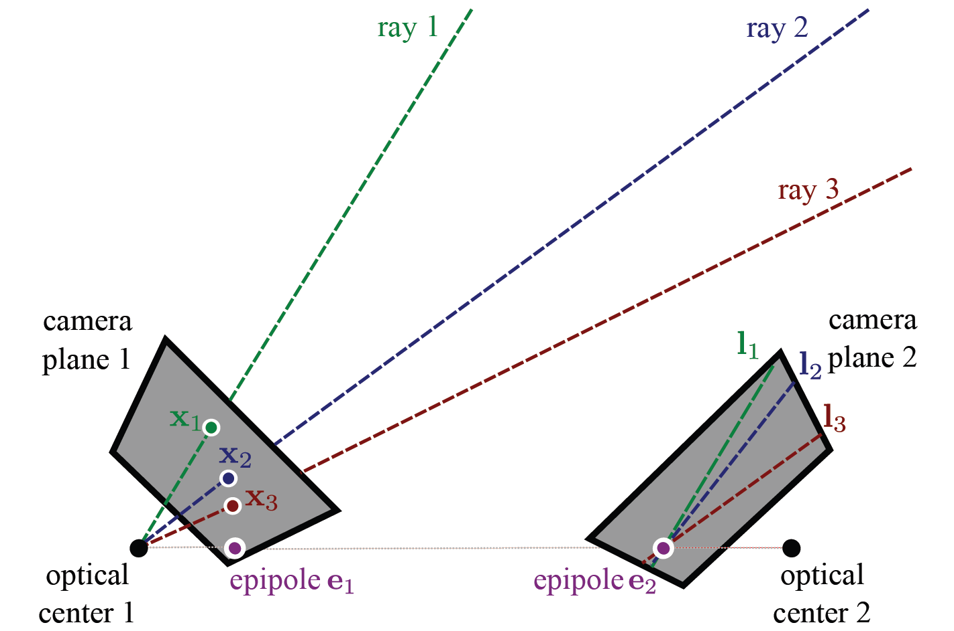



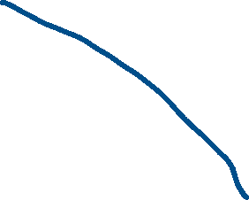
















Epipole
Computer vision: models, learning and inference. ©2011 Simon J.D. Prince
6

Slide 7
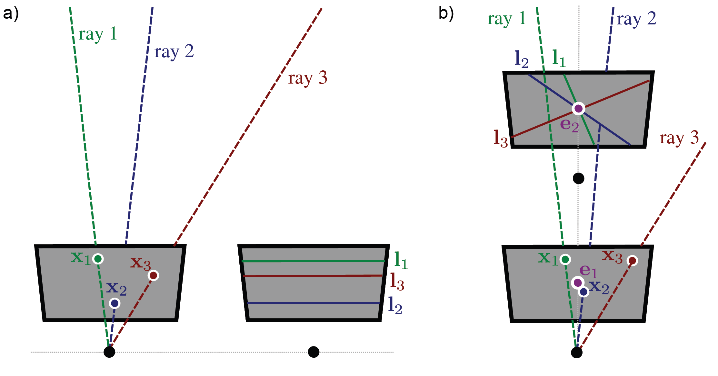
Special configurations
Computer vision: models, learning and inference. ©2011 Simon J.D. Prince
7

Slide 8

Structure
Two view geometry
The essential and fundamental matrices
Reconstruction pipeline
Rectification
Multi-view reconstruction
Applications
Computer vision: models, learning and inference. ©2011 Simon J.D. Prince
8

Slide 9
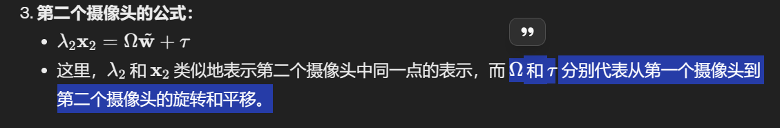
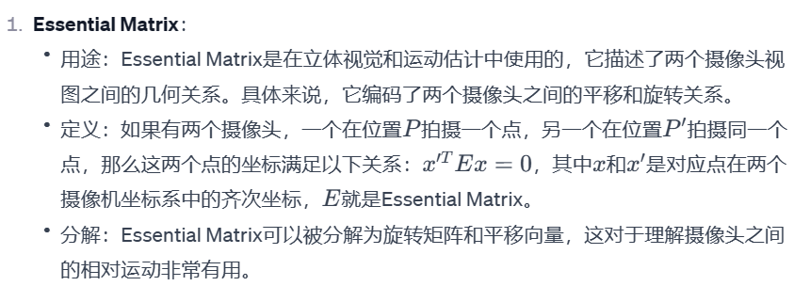
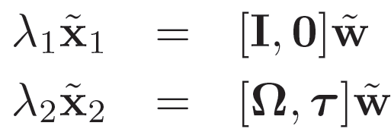
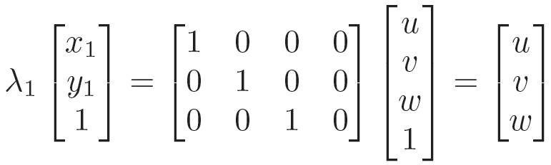
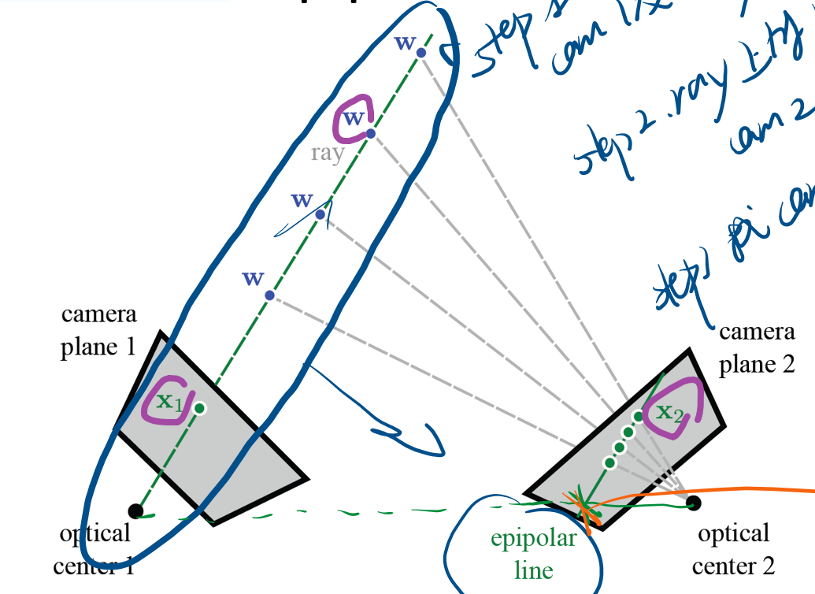
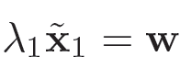
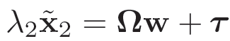





The essential matrix
The geometric relationship between the two cameras is captured by the essential matrix.
Assume normalized cameras, first camera at origin.
First camera:
Second camera:
Computer vision: models, learning and inference. ©2011 Simon J.D. Prince
9

Slide 10
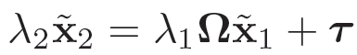
The essential matrix
First camera:
Second camera:
Substituting:
This is a mathematical relationship between the points in the two images, but it’s not in the most convenient form.
Computer vision: models, learning and inference. ©2011 Simon J.D. Prince
10

Slide 11
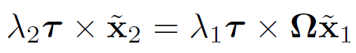
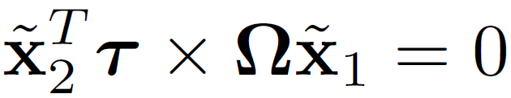
The essential matrix
Take cross product with τ (last term disappears)
Take inner product of both sides with x₂.
Computer vision: models, learning and inference. ©2011 Simon J.D. Prince
11

Slide 12
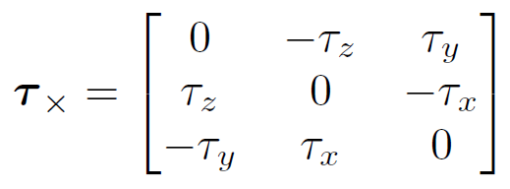
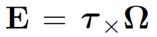
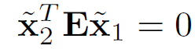


The essential matrix
The cross product term can be expressed as a matrix
Defining:
We now have the essential matrix relation
Computer vision: models, learning and inference. ©2011 Simon J.D. Prince
12

Slide 13
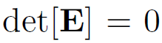
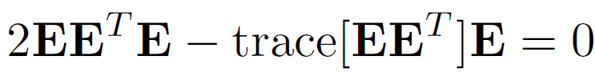
Properties of the essential matrix
Rank 2:
5 degrees of freedom
Non-linear constraints between elements
Computer vision: models, learning and inference. ©2011 Simon J.D. Prince
13

Slide 14
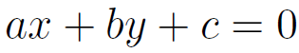
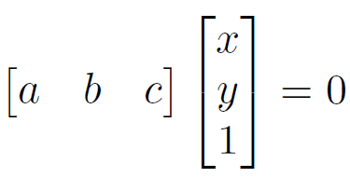
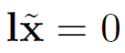
Recovering epipolar lines
Equation of a line:
or
or
Computer vision: models, learning and inference. ©2011 Simon J.D. Prince
14

Slide 15
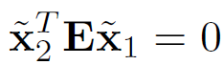
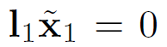
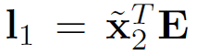
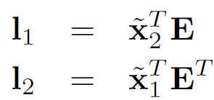
Recovering epipolar lines
Equation of a line:
Now consider
This has the form where
So the epipolar lines are
Computer vision: models, learning and inference. ©2011 Simon J.D. Prince
15

Slide 16
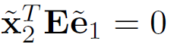
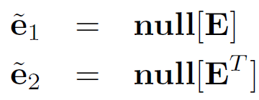
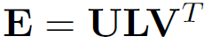
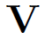



Recovering epipoles
Every epipolar line in image 1 passes through the epipole e₁.
In other words for ALL
This can only be true if e₁ is in the nullspace of E.
Similarly:
We find the null spaces by computing , and taking the last column of and the last row of .
Computer vision: models, learning and inference. ©2011 Simon J.D. Prince
16

Slide 17
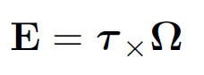
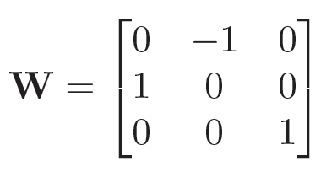
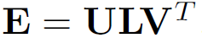
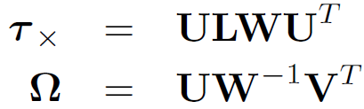
Decomposition of E
Essential matrix:
To recover translation and rotation use the matrix:
We take the SVD and then we set
Computer vision: models, learning and inference. ©2011 Simon J.D. Prince
17

Slide 18
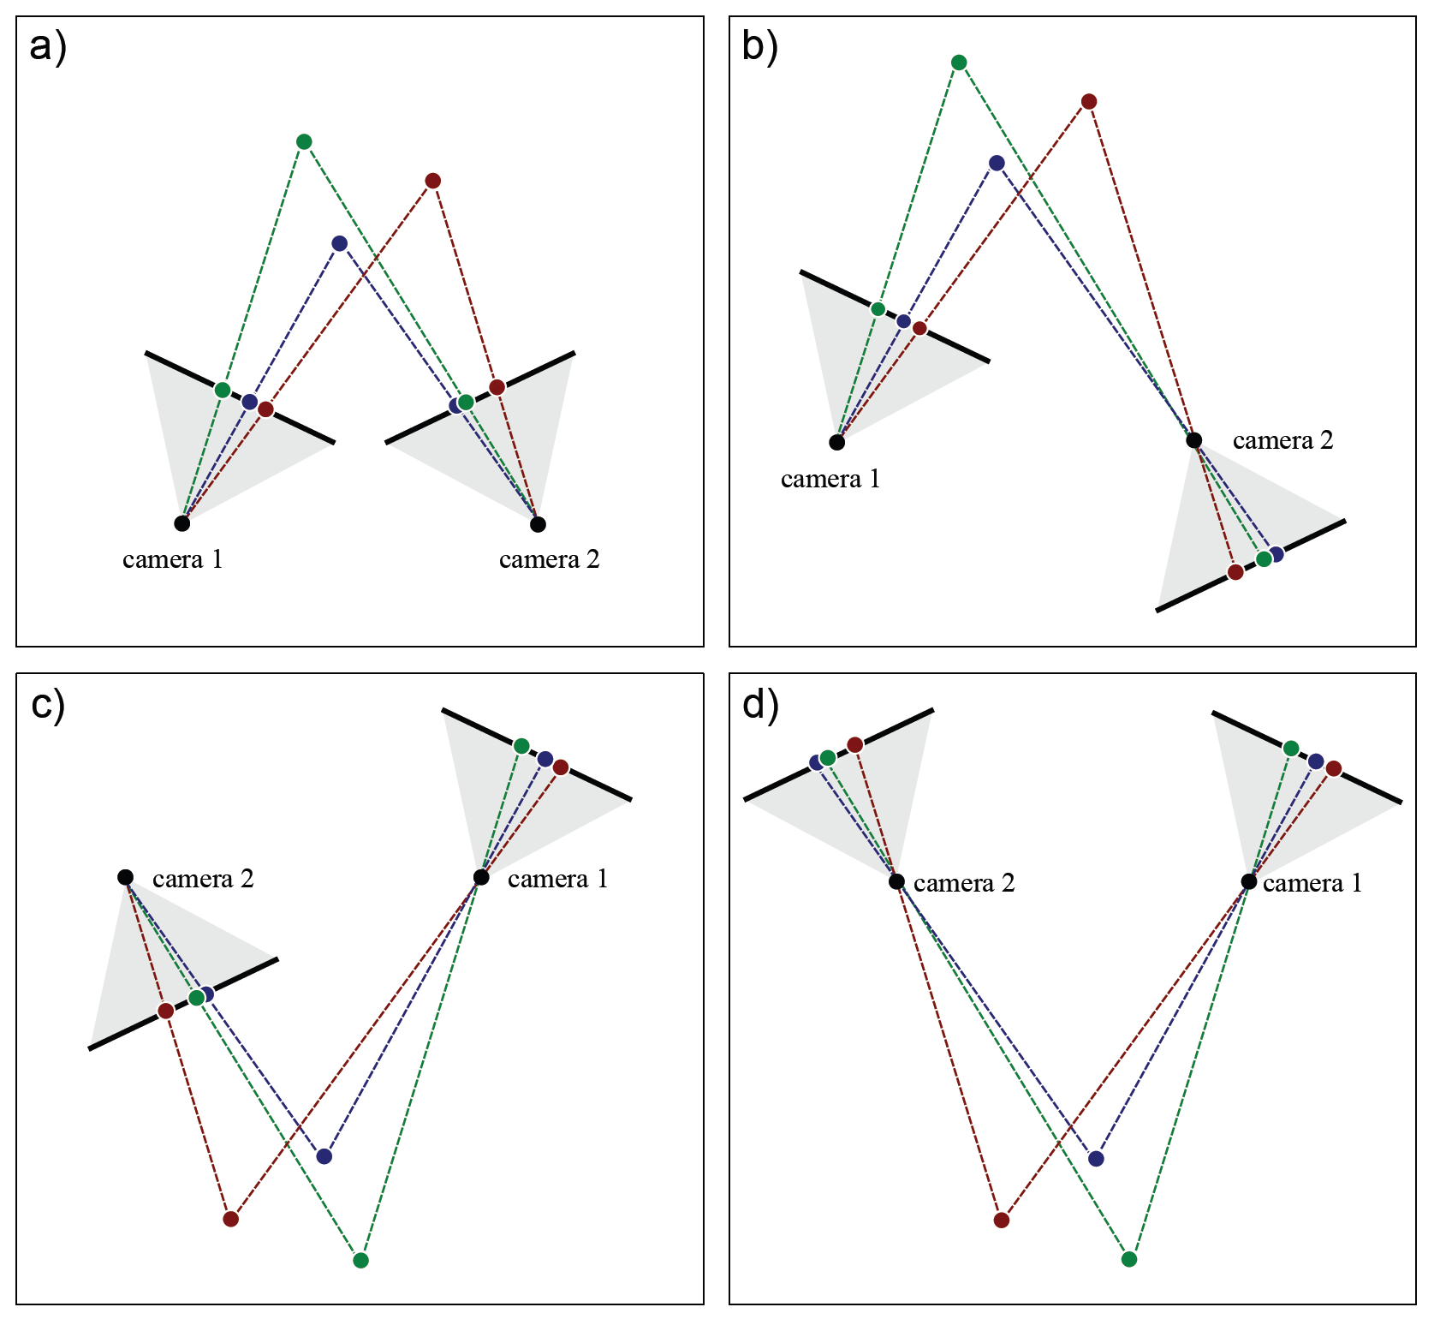
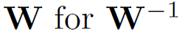
Four interpretations
To get the different solutions, we mutliply τ by -1 and substitute
Computer vision: models, learning and inference. ©2011 Simon J.D. Prince
18

Slide 19
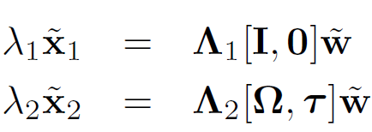
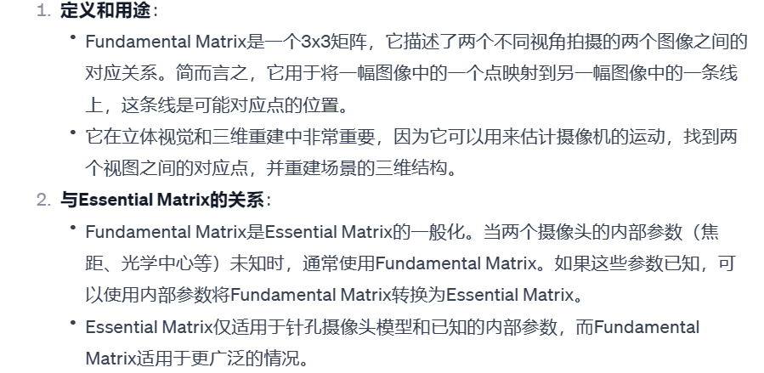
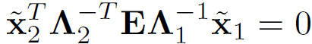
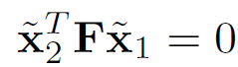
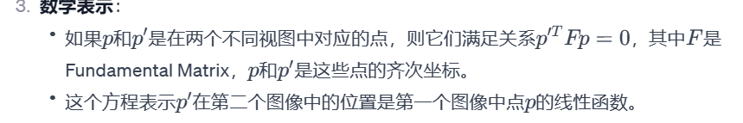
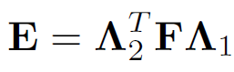


The fundamental matrix
Now consider two cameras that are not normalised
By a similar procedure to before, we get the relation
or
where
Relation between essential and fundamental
Computer vision: models, learning and inference. ©2011 Simon J.D. Prince
19

Slide 20
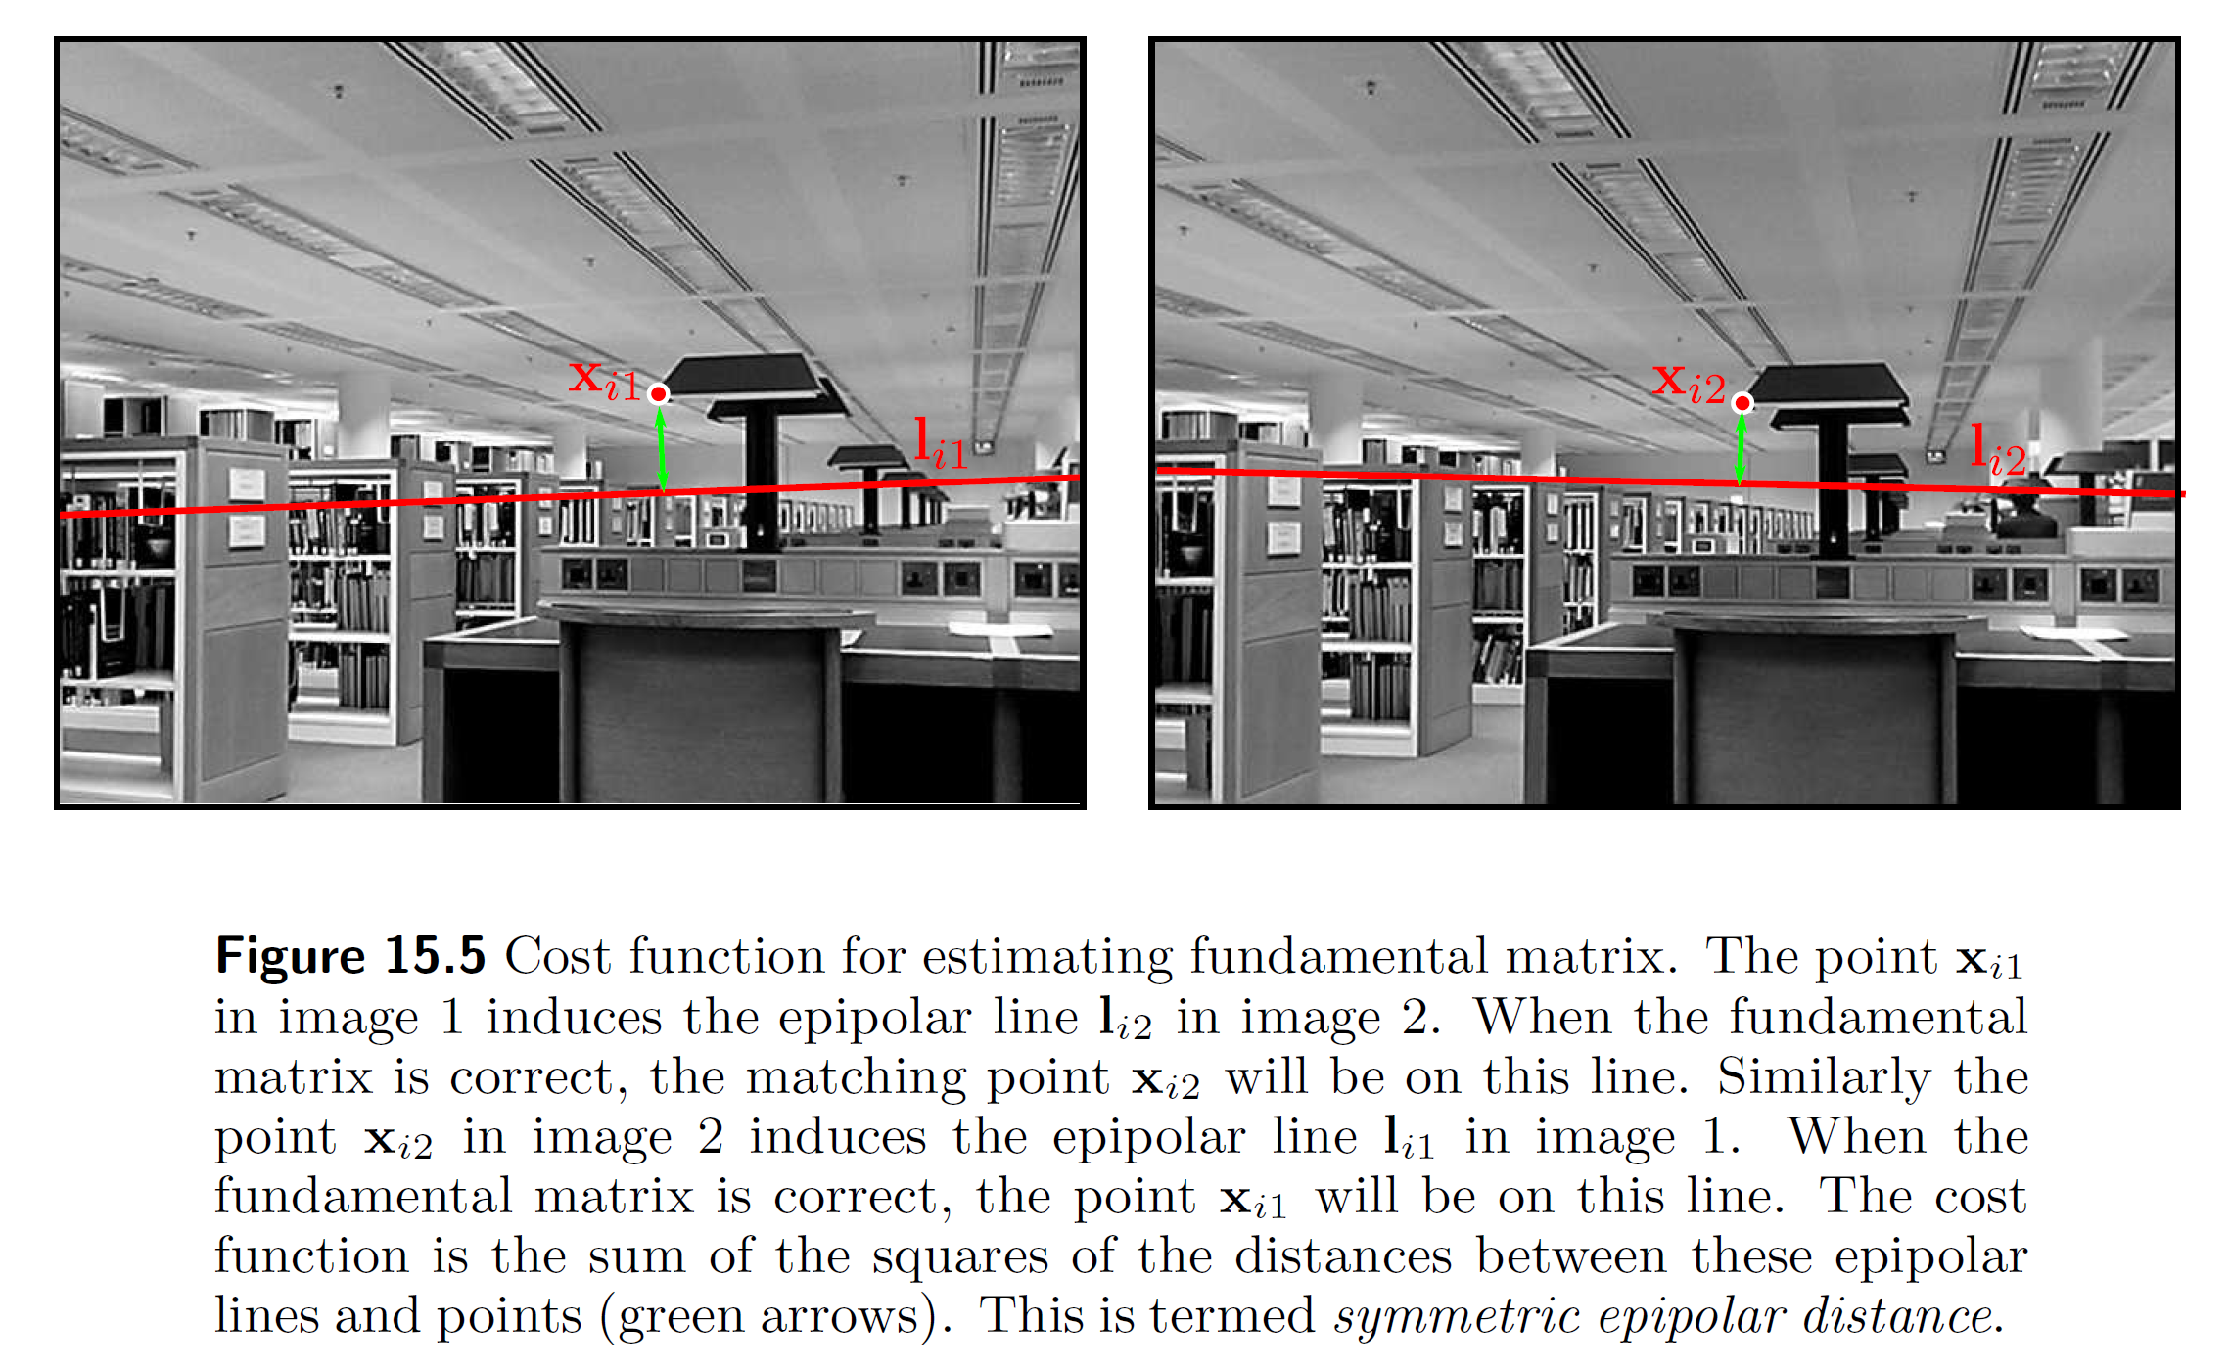
Fundamental matrix criterion
Computer vision: models, learning and inference. ©2011 Simon J.D. Prince
20

Slide 21




Estimation of fundamental matrix
When the fundamental matrix is correct, the epipolar line induced by a point in the first image should pass through the matching point in the second image and vice-versa.
This suggests the criterion
If and then
Unfortunately, there is no closed form solution for this quantity.
Computer vision: models, learning and inference. ©2011 Simon J.D. Prince
21

Slide 22

The 8 point algorithm
Approach:
solve for fundamental matrix using homogeneous coordinates
closed form solution (but to wrong problem!)
Known as the 8 point algorithm
Start with fundamental matrix relation
Writing out in full:
or
Computer vision: models, learning and inference. ©2011 Simon J.D. Prince
22

Slide 23

The 8 point algorithm
Can be written as:
where
Stacking together constraints from at least 8 pairs of points, we get the system of equations
Computer vision: models, learning and inference. ©2011 Simon J.D. Prince
23

Slide 24






The 8 point algorithm
Minimum direction problem of the form , Find minimum of subject to .
To solve, compute the SVD and then set to the last column of .
Computer vision: models, learning and inference. ©2011 Simon J.D. Prince
24

Slide 25

Fitting concerns
This procedure does not ensure that solution is rank 2. Solution: set last singular value to zero.
Can be unreliable because of numerical problems to do with the data scaling – better to re-scale the data first
Needs 8 points in general positions (cannot all be planar).
Fails if there is not sufficient translation between the views
Use this solution to start non-linear optimisation of true criterion (must ensure non-linear constraints obeyed).
There is also a 7 point algorithm (useful if fitting repeatedly in RANSAC)
Computer vision: models, learning and inference. ©2011 Simon J.D. Prince
25

Slide 26
Structure
Two view geometry
The essential and fundamental matrices
Reconstruction pipeline
Rectification
Multi-view reconstruction
Applications
Computer vision: models, learning and inference. ©2011 Simon J.D. Prince
26

Slide 27

Two view reconstruction pipeline
Start with pair of images taken from slightly different viewpoints
Computer vision: models, learning and inference. ©2011 Simon J.D. Prince
27

Slide 28

Two view reconstruction pipeline
Find features using a corner detection algorithm
Computer vision: models, learning and inference. ©2011 Simon J.D. Prince
28

Slide 29

Two view reconstruction pipeline
Match features using a greedy algorithm
Computer vision: models, learning and inference. ©2011 Simon J.D. Prince
29

Slide 30

Two view reconstruction pipeline
Fit fundamental matrix using robust algorithm such as RANSAC
Computer vision: models, learning and inference. ©2011 Simon J.D. Prince
30

Slide 31

Two view reconstruction pipeline
Find matching points that agree with the fundamental matrix
Computer vision: models, learning and inference. ©2011 Simon J.D. Prince
31

Slide 32

Two view reconstruction pipeline
Extract essential matrix from fundamental matrix
Extract rotation and translation from essential matrix
Reconstruct the 3D positions w of points
Then perform non-linear optimisation over points and rotation and translation between cameras
Computer vision: models, learning and inference. ©2011 Simon J.D. Prince
32

Slide 33

Two view reconstruction pipeline
Reconstructed depth indicated by color
Computer vision: models, learning and inference. ©2011 Simon J.D. Prince
33

Slide 34

Dense Reconstruction
We’d like to compute a dense depth map (an estimate of the disparity at every pixel)
Approaches to this include dynamic programming and graph cuts
However, they all assume that the correct match for each point is on the same horizontal line.
To ensure this is the case, we warp the images
This process is known as rectification
Computer vision: models, learning and inference. ©2011 Simon J.D. Prince
34

Slide 35
Structure
Two view geometry
The essential and fundamental matrices
Reconstruction pipeline
Rectification
Multi-view reconstruction
Applications
Computer vision: models, learning and inference. ©2011 Simon J.D. Prince
35

Slide 36



Rectification
We have already seen one situation where the epipolar lines are horizontal and on the same line:
when the camera movement is pure translation in the u direction.
Computer vision: models, learning and inference. ©2011 Simon J.D. Prince
36

Slide 37





Planar rectification
Apply homographies and to image 1 and 2
Computer vision: models, learning and inference. ©2011 Simon J.D. Prince
37

Slide 38



Planar rectification
Start with which breaks down as
Move origin to center of image
Rotate epipole to horizontal direction
Move epipole to infinity
Computer vision: models, learning and inference. ©2011 Simon J.D. Prince
38

Slide 39


Planar rectification
There is a family of possible homographies that can be applied to image 1 to achieve the desired effect
These can be parameterized as
One way to choose this, is to pick the parameter that makes the mapped points in each transformed image closest in a least squares sense:
where
Computer vision: models, learning and inference. ©2011 Simon J.D. Prince
39

Slide 40
Before rectification
Before rectification, the epipolar lines converge
Computer vision: models, learning and inference. ©2011 Simon J.D. Prince
40

Slide 41

After rectification
After rectification, the epipolar lines are horizontal and aligned with one another
Computer vision: models, learning and inference. ©2011 Simon J.D. Prince
41

Slide 42

Polar rectification
Planar rectification does not work if epipole lies within the image.
Computer vision: models, learning and inference. ©2011 Simon J.D. Prince
42

Slide 43
Polar rectification
Polar rectification works in this situation, but distorts the image more
Computer vision: models, learning and inference. ©2011 Simon J.D. Prince
43

Slide 44

Dense Stereo
Computer vision: models, learning and inference. ©2011 Simon J.D. Prince
44

Slide 45
Structure
Two view geometry
The essential and fundamental matrices
Reconstruction pipeline
Rectification
Multi-view reconstruction
Applications
Computer vision: models, learning and inference. ©2011 Simon J.D. Prince
45

Slide 46

Multi-view reconstruction
Computer vision: models, learning and inference. ©2011 Simon J.D. Prince
46

Slide 47
Multi-view reconstruction
Computer vision: models, learning and inference. ©2011 Simon J.D. Prince
47

Slide 48
Reconstruction from video
Images taken from same camera; can also optimise for intrinsic parameters (auto-calibration)
Matching points is easier as can track them through the video
Not every point is within every image
Additional constraints on matching: three-view equivalent of fundamental matrix is tri-focal tensor
New ways of initialising all of the camera parameters simultaneously (factorisation algorithm)
Computer vision: models, learning and inference. ©2011 Simon J.D. Prince
48

Slide 49




Bundle Adjustment
Bundle adjustment refers to process of refining initial estimates of structure and motion using non-linear optimisation.
This problem has the least squares form:
where:
Computer vision: models, learning and inference. ©2011 Simon J.D. Prince
49

Slide 50



Bundle Adjustment
This type of least squares problem is suited to optimisation techniques such as the Gauss-Newton method:
Where
The bulk of the work is inverting J^{T}J. To do this efficiently, we must exploit the structure within the matrix.
Computer vision: models, learning and inference. ©2011 Simon J.D. Prince
50

Slide 51
Structure
Two view geometry
The essential and fundamental matrices
Reconstruction pipeline
Rectification
Multi-view reconstruction
Applications
Computer vision: models, learning and inference. ©2011 Simon J.D. Prince
51

Slide 52

3D reconstruction pipeline
Computer vision: models, learning and inference. ©2011 Simon J.D. Prince
52

Slide 53

Photo-Tourism
Computer vision: models, learning and inference. ©2011 Simon J.D. Prince
53

Slide 54

Volumetric graph cuts
Computer vision: models, learning and inference. ©2011 Simon J.D. Prince
54

Slide 55
Conclusions
Given a set of a photos of the same rigid object, it is possible to build an accurate 3D model of the object and reconstruct the camera positions
Ultimately relies on a large-scale non-linear optimisation procedure.
Works if optical properties of the object are simple (no specular reflectance etc.)
Computer vision: models, learning and inference. ©2011 Simon J.D. Prince
55

